Slide 1
Life Expectancy
Kevin Diaz

Slide 2
Key
Concepts
Introduction and Background
Research Question
Dataset description
Variable Introduction
Data summary Statistics
Data Mining Methods
Model Evaluations
Practical Implications
Scope of the Guidelines

Slide 3

Introduction
Of life expectancy
The current pandemic has forced the leaders of our nations to act and make life changing decisions
The lives of many people around the world have been impacted heavily
The last couple of months have clarified what truly matters, living a long and healthy life
Notes:
The current pandemic has forced the leaders of our nations to act, and the decisions we make now will be scrutinized by our descendants as they reverberate for years to come. During this time, many have been torn away from their own families and have had to endure the experience of losing loved ones. Others fear for their own lives as they struggle to remain afloat. The last couple of months have clarified what truly matters, living a long and healthy life.

Slide 4
Background
Life expectancy is an average measure representing the expected years of life
One thing to note, however, is that life expectancy has been on an increasing trend as of the last few years
Those with underlying health risks are at most risk during the pandemic, therefore understanding which factors can enable a healthier life can help policy makers improve their allocation of resources
Notes:
Life expectancy is an average measure given to represent the expected number of years of life for a person depending on a variety of factors. As technology improves people have access to more information and governments can promote better treatment for the poorest of their communities. Some developing countries do not have the facilities to provide a basic level of healthcare and may be unable to adequately distribute the immunizations needed for their people. Generally, people who live in the same areas tend to have similar life expectancies. Within these areas politics dictates who gets what resources and how the government moves forward to guarantee the health of their people. Unpredictable and rampant diseases have also contributed to lowering life expectancy and force officials to decide who receives treatments and vaccines. However in the last few decades, the world health organization have witnessed a noticeable increase in predicted life expectancy for residents within a plethora of countries. Those with underlying health risks are at most risk during the pandemic, therefore understanding which factors can enable a healthier life can help policy makers improve their allocation of resources. Although we are working with a limited dataset that cannot encapsulate all of the factors that truly affect our dependent variable, we aim to prove that there are a couple of prominent variables that can drastically improve life expectancy age and are worth looking into by government officials.

Slide 5

Research Question
We intend to determine which variables will influence life expectancy age?

Slide 6
Dataset Information
Published
Includes
Contains
Observations
Variables
Published by the Global Health Observatory (GHO) data repository under WHO
Includes information for predicted life expectancy for 193 countries between 2000-2015
Contains missing values
Has 2939 observations
Has 21 variables
Predicting Variables
Continent
This includes the variable “Continent” which we added using python
We only use 18 predicting variables (not including life expectancy)
Notes:
Our team intends to analyze a dataset published by the Global Health Observatory (GHO) data repository under the World Health Organization. The GHO data repository is a streamlined source regarding global health and “Research and development activities”. The information within this database is publicized so that policy makers and researchers can ensure that public health needs are met and to secure the best allocation of their nation’s resources. Although the data set contains some missing values, the Kaggle page notes that most of the missing data are for the following predictors: population, Hepatitis B and GDP and from less known countries like Vanuatu, Tonga, Togo, Cabo Verde etc. Out of the 2939 observations, and 23 variables in our dataset, we decided to only use 18 predicting variables. The variable Life Expectancy is not included in our predicting variables since it will serve as the response. We decided to exclude the variable year from our model because a direct correlation between the current year and the life expectancy of a country does not exist. Our number of 18 also includes the variable “Continent” which we added onto the dataset ourselves. This was done using python where I created a mapping for each country and its respective continent based off classifications from “Britannica.com.” This code will be attached separately from the R code used for the rest of the report.

Slide 7
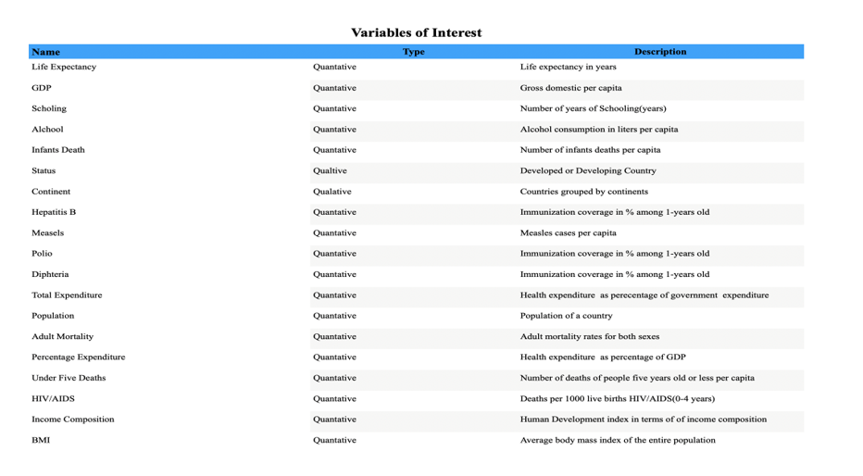

Slide 8
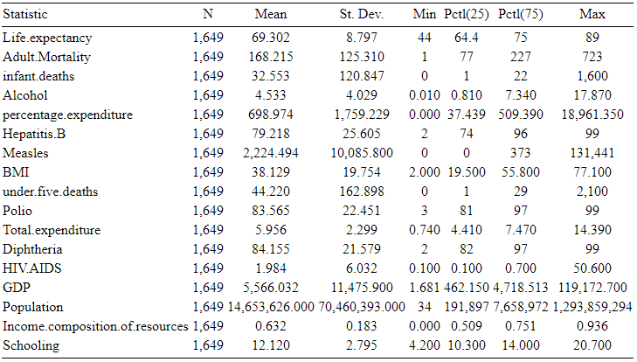
Table 1
1649 observations
Life Expectancy
Min: 44
Max:89
St. Dev. 8.797
We aim to explain why the discrepancy exists
Notes:
Here we have a table summarizing some important attributes for the dataset we used in our study. Notably, the dataset originally contained 2939 observations but after omitting any observations with missing values, we can see that the new dataset contains 1649 observations. The dependent variable we are highlighting of life expectancy demonstrates a large contrast between its minimum (44) and maximum (89) age values. Furthermore, we can also see that the standard deviation for life expectancy across countries is sizable. Our study aims to try and explain why this discrepancy exists and to attribute which of the variables above best explain the age values

Slide 9
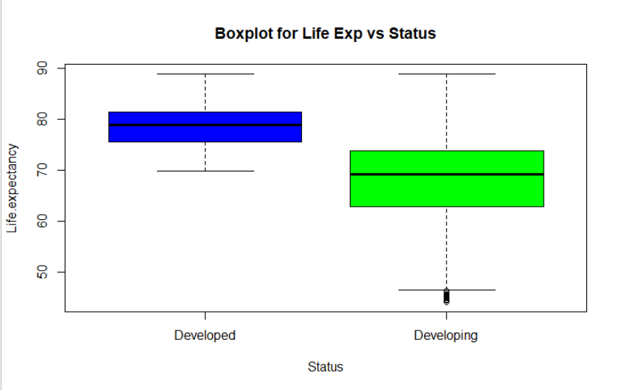
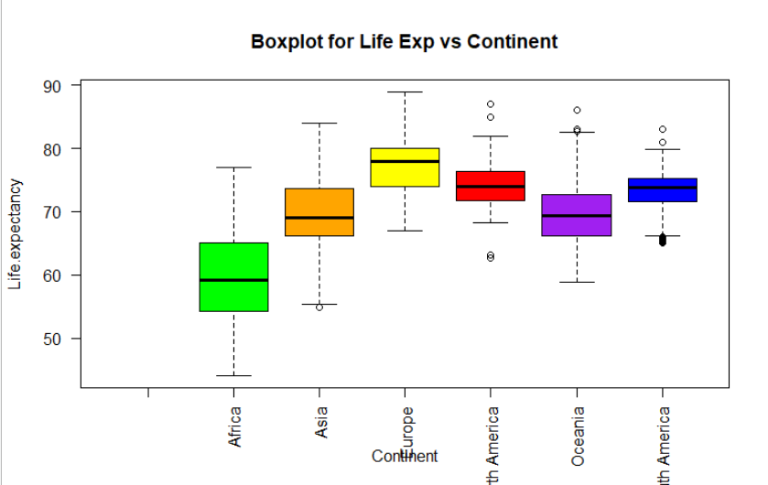
Data Summary Statistics
Life expectancy is plotted on the Y axis against the only two qualitative predictors, Status and Continent
Status boxplot
Status boxplot shows higher life expectancy can be expected from developed countries
Why?
Median value is higher compared to developing
Significant difference in the minimum expected life expectancy value between the two
Continent boxplot
Continent boxplot shows North America, South America and Europe have the highest median value whereas Africa has the lowest median value
Notes:
Here we have two boxplots used in the exploratory analysis stage to gain an understanding of the two qualitative predictors not represented in Figure 1. Figure 2 displays values for life expectancy plotted on the Y axis against status on the X axis, whereas Figure 2 has the Continents on the X axis. Figure 2 shows that generally we can expect a higher life expectancy from developed countries as opposed to developing ones. We came to this conclusion since the median value for life expectancy is much higher for developed compared to that of developing and there is a significant difference in the minimum expected life expectancy value between the two. On the other hand, from examining Figure 3 we can see that North America, South America and Europe have the highest median value whereas Africa has the lowest median value. Therefore, we concluded that these continents generally benefit from a longer life expectancy.

Slide 10
Data Mining Methods
Multilinear Regression
Variance Inflation Factor
Backwards Stepwise Regression
Cross Validation
Validation Set Approach
Regression Tree
Cross Validation
Model Evaluation
Notes:
Based off our results from the exploratory analysis stage, we were led to believe that both status and continent are potentially two significant factors in determining life expectancy. Therefore, we built two multi-linear regression models, each containing a different categorical variable, to determine which of the two results in a more accurate prediction. Each model began with all predictors, then we utilized the Variance Inflation Factor to iteratively remove variables that displayed high risk of collinearity. Then we followed the backwards selection method to continue to remove predictors based on level of significance until we reached a model where all predictors were statistically significant at the 0.1 level of confidence. Afterwards, we decided to perform cross validation to get an estimate of test-set prediction error for both models and compare between the two. We then used the model with the lower Mean Squared Error to build a regression tree.

Slide 11
Multi-linear Regression
Removed
Two models
Best model
Variance Inflation Factor
Removed empty observations resulting in 1,649 observations
Two multi linear regression models, one for Status, another for Continent
First we produced best regression model for one with Status
Used Variance Inflation Factor to find instances of multicollinearity.
High VIF
Predictors
Second model
Model
Infant deaths and GDP both showed high Vif values and were removed accordingly
All predictors were significant at the 0.1 level, so we stopped here
For the 2nd model with status, we used the VIF
Infant deaths and GDP both showed high VIF values and were removed accordingly
Still had a model where not every predictor was significant
Began removing predictors with the highest P-value
Obtained reduced model after removing Total Expenditure, Hepatitis B, and Population through backwards stepwise selection
Notes:
We used na.omit to remove empty observations, resulting in 1649 total observations.
We have two multi linear regression models, one that contains Country Status and the other that contains the Continent name.
First we wanted to produce the best model we could for the one containing Country status.
We used the Variance Inflation Factor in order to find instances of multicollinearity.
We found that variables infant deaths and GDP both showed high Vif values and were removed accordingly.
We now had a model where all predictors were significant at the 0.1 level, so we stopped here.
For the second model which contains the country status, we again used the Variance Inflation Factor.
Again we found that variables infant deaths and GDP both showed high Vif values and were removed accordingly.
However, we still had a model where not every predictor was significant.
To get a better model we began removing predictors with the highest P-value.
By the end, we had a reduced model that best explains the data and where we removed Total Expenditure, Hepatitis B, and Population through backwards stepwise regression.

Slide 12
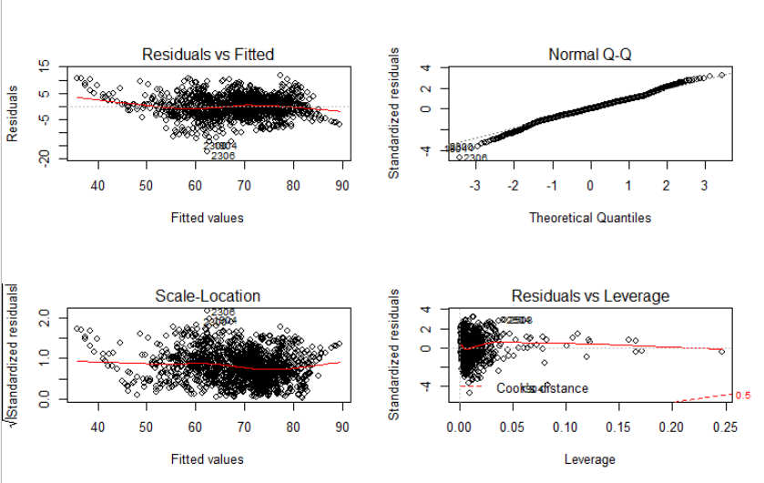
Model 1 Residual Plots
Notes:
starting off with the “Non-Linearity of the response-predictor relationship assumption” for the model containing status. For this problem we plot the residuals against the predicted values of y which shows some evidence of a discernible pattern but not enough to conclude a violation of the assumption. The second problem that we address is the Non-constant variance of error terms, which we can conclude does not show pattern of heteroscedasticity and does not violate assumption of equal variance from examining the Scale-location plot. Residuals vs Leverage shows that all outliers are within cook’s distance and that the model is acceptable in terms of leverage points. Lastly, Normal Q-Q shows that the residuals are relatively normally distributed by not deviating severely from the straight line pattern.

Slide 13
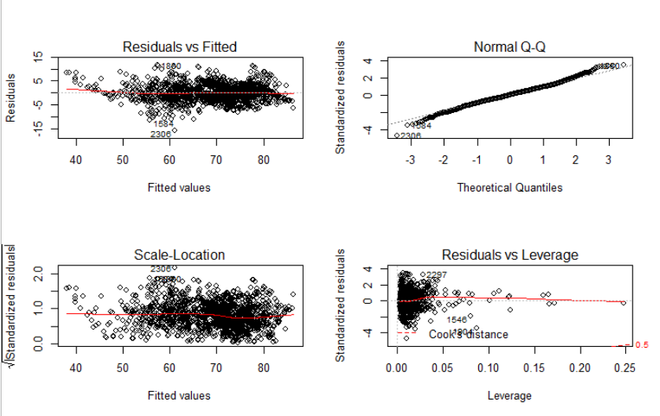
Model 2 Residual Plots
Notes:
Moreover, for the model containing Continents we can see from residuals vs fitted that there is not a violation of the linearity assumption. Scale - location shows that we do not see any evidence of heteroscedasticity. Normal Q-Q shows that the residuals are once again relatively normally distributed and do not deviate severely from the straight line pattern. Lastly, Residuals vs Leverage does not show alarming evidence of residuals outside of cook’s distance or high leverage points.

Slide 14
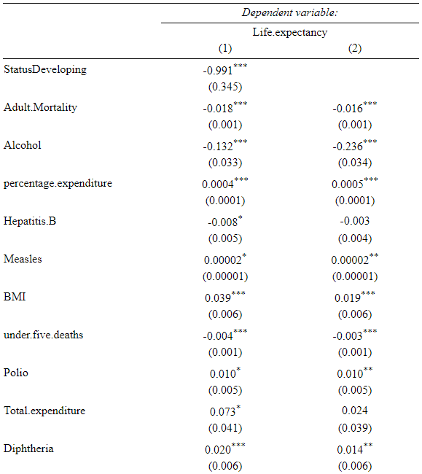
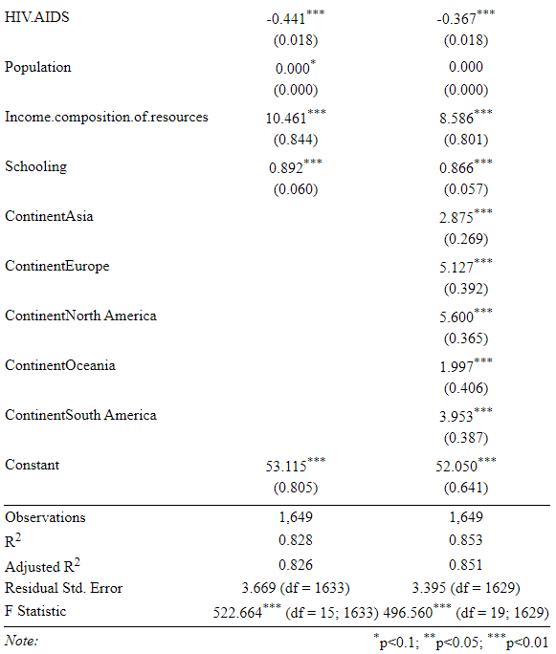

Slide 15
Results from Model 1 & Model 2
Status Model
Continent Model
Developing Countries will have a lower life expectancy than developed countries
Income composition of resources has the largest positive effect on life expectancy
Under five deaths, alcohol, HIV/AIDS, Adult Mortality, Hepatitis B have a negative effect on life expectancy in both models
BMI, Schooling, Percentage Expenditure, Measles, Polio, Diphtheria has a positive effect on life expectancy for both models
Europe, Asia, Oceania, North America, and South America have a higher life expectancy than Africa
North America has the highest life expectancy
R-Squared value for continents shows that it can explain the variability in life expectancy better than the status model
Total expenditure, Hepatitis B, and population are not significant in the continent model

Slide 16
Cross Validation
Validation Set Approach
Status Model MSE
Continent Model MSE
We split our dataset in half without replacement and set one half to represent the training data set.
Ran linear regression for both models based on the training dataset.
Calculated the Mean Squared Error values for both based on the validation sample.
Status model MSE = 13.54407
Continent model MSE = 12.3996
Continent is the better model out of the two
Notes:
Cross Validation is done to obtain an estimate of test-set prediction error.
We are taking the Validation Set approach which means that we split our dataset in half without replacement and set one half to represent the training data set.
We ran linear regression for both models based on the training dataset.
Then we calculated the Mean Squared Error values for both based on the validation sample.
Our hopes in cross validation were to be able to choose the better model out of the two by comparing their Mean Squared Error values.
The model containing status had an MSE value of 13.54407
The model containing Continent had an MSE value of 12.3996
Therefore, these estimates give us an idea of the test error of the final chosen model and we can conclude that the model containing Continent is the better model out of the two.
However, the validation set approach is highly variable and can overestimate the test error of the final model.
The reason is because its dependent on which observations end up in the training data set rather than the validation set.
Therefore, we can either try a different resampling method or we can fit the model using a regression tree then perform cross validation on the tree to determine the optimal level of tree complexity. (someone check this)

Slide 17
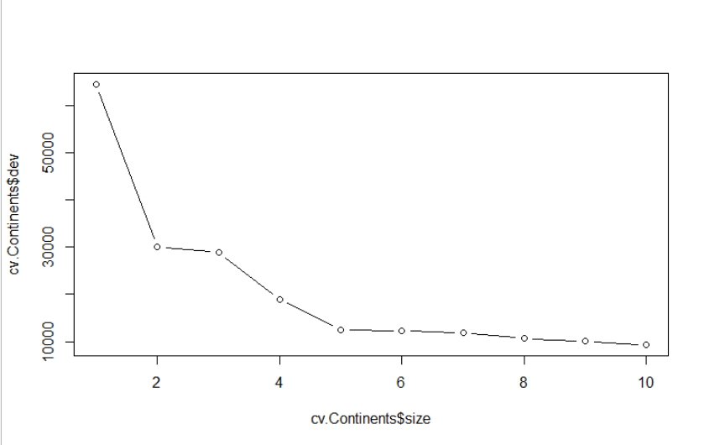
Regression Tree
Applied Continent model to a regression tree
Validation set approach - split our observations in half
Fit the model and the value for residual mean deviance was 9.394
Relatively small value which means our model fits well
Our resulting model had a tree size of 10
Used cross validation to determine the best tree size and found that a tree size of 10 is the optimal value
Plot of the tree’s size against its deviance shows deviance minimized when tree size equals 10
We did not have to prune tree
Notes:
We decided that using a regression tree would be a better option because it can accommodate the additional predictors and clarifies which predictors most affect life expectancy.
We took the better model out of the two which was the one containing continent and applied it to a regression tree.
Once again, we start with validation set approach, splitting our observations in half.
We then fit the model and took a look at the residual mean deviance which in the case of regression is simply the sum of squared errors for the tree and it tells us how well the model fits the data.
The value for residual mean deviance is 9.394 which is a relatively small value which means our model fits well.
Our resulting model has a tree size of 10.
We then used cross validation to determine the best tree size and found that a tree size of 10 is the optimal value.
Therefore, we did not have to prune our tree and we can use this unpruned tree to make prediction on the test data set.
Here we have a plot of the tree’s size against its deviance to prove that our original tree was the best.
According to the plot, value of 10 is the best tree size so we did not have to prune our tree.
On the second plot we can see how the true y compares to the predicted y.
The plot shows that our model’s predictions follows a similar trend to the real values.

Slide 18
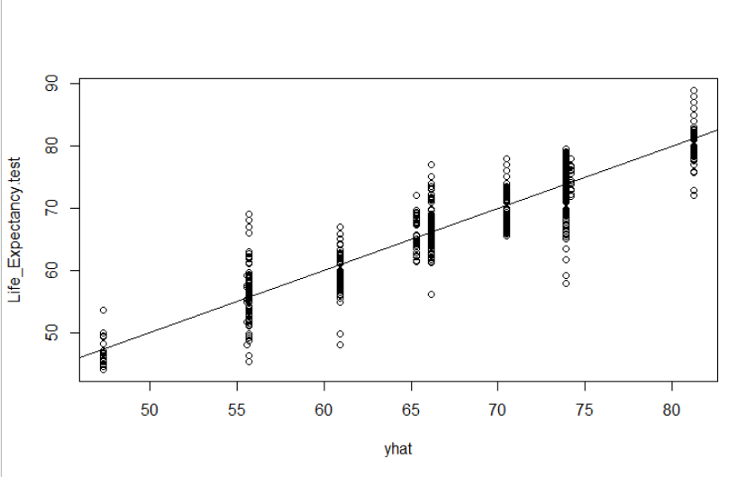
Model Evaluation
We used MSE to evaluate the model’s accuracy and to compare to our previous MSE values.
Our MSE value came out to 11.14319
In comparison to our previous MSE values, the value after creating the regression tree was significantly lower.
11.14319 < 13.54407(Status)
11.14319 < 12.3996 (Continent))
Therefore, we can select our resulting model as the best out of the models we found
Notes:
We decided that using a regression tree would be a better option because it can accommodate the additional predictors and clarifies which predictors most affect life expectancy.
We took the better model out of the two which was the one containing continent and applied it to a regression tree.
Once again, we start with validation set approach, splitting our observations in half.
We then fit the model and took a look at the residual mean deviance which in the case of regression is simply the sum of squared errors for the tree and it tells us how well the model fits the data.
The value for residual mean deviance is 9.394 which is a relatively small value which means our model fits well.
Our resulting model has a tree size of 10.
We then used cross validation to determine the best tree size and found that a tree size of 10 is the optimal value.
Therefore, we did not have to prune our tree and we can use this unpruned tree to make prediction on the test data set.
Here we have a plot of the tree’s size against its deviance to prove that our original tree was the best.
According to the plot, value of 10 is the best tree size so we did not have to prune our tree.
On the second plot we can see how the true y compares to the predicted y.
The plot shows that our model’s predictions follows a similar trend to the real values.

Slide 19
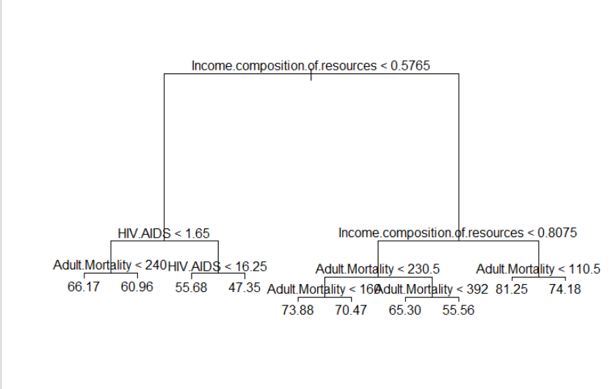
Decision Tree Results
Notes:
starting off with the “Non-Linearity of the response-predictor relationship assumption” for the model containing status. For this problem we plot the residuals against the predicted values of y which shows some evidence of a discernible pattern but not enough to conclude a violation of the assumption. The second problem that we address is the Non-constant variance of error terms, which we can conclude does not show pattern of heteroscedasticity and does not violate assumption of equal variance from examining the Scale-location plot. Residuals vs Leverage shows that all outliers are within cook’s distance and that the model is acceptable in terms of leverage points. Lastly, Normal Q-Q shows that the residuals are relatively normally distributed by not deviating severely from the straight line pattern.

Slide 20
Conclusion
"Income.composition.of.resources", "HIV.AIDS" and "Adult.Mortality" were the most influential.
From the tree on the previous slide, the most important factor is the income composition of resources predictor towards predicting life expectancy which is consistent with our regression results.
If Income composition of resources > 0.8075 but Adult Mortality < 110.5 then we get the highest predicted value of life expectancy at 81.25.
On the other hand, if the value for income composition of resources < 0.5765 but the value of HIV.AIDS is > 16.25 then we predict a value of 47.35 for life expectancy which is the lowest value among the terminal nodes.
Notes:
Rather, the three most influential to building the model were "Income.composition.of.resources", "HIV.AIDS" and "Adult.Mortality"
From the tree, we can see that the most important factor is the income composition of resources predictor towards predicting life expectancy. If an observation has an income composition of resources value greater than 0.8075 but an Adult Mortality lower than 110.5 then we get the highest predicted value of life expectancy at 81.25. On the other hand, if the value for income composition of resources is less than 0.5765 but the value of HIV.AIDS is greater than 16.25 then we predict a value of 47.35 for life expectancy which is the lowest value among the terminal nodes.

Slide 21
Practical Implications
Since Income composition of resources is an index composed of multiple predictors then we cannot conclude there is a single predictor responsible for life expectancy.
Instead, this should communicate to decision makers that prioritizing health, social and economic variables can result in a high life expectancy since the variable that encompassed a variety of factors was the most important.
Furthermore, trying to predict an individual's precise life expectancy from our model is impractical, considering all the other variables in life that can’t be accounted for. Rather this is a representation of what can be expected at a broader level.
HIV.AIDS being one of the best predictors makes sense as well because this factor does not measure immunizations but rather death rates among 0-4 years old in 1000 live births, as opposed to Diptheria, Hepatitis B, and Measles which do measure immunizations.
The other virus that does not measure immunizations is measles but the difference is that there is a known measles vaccine whereas there is none for AIDS/HIV which is why it is more relevant towards predicting life expectancy.
Notes:
The importance of income composition of resources makes sense because it is an index for how countries use their resources effectively.
However, since it is an index composed of multiple predictors then we cannot conclude there is a single predictor responsible for life expectancy.
Instead, this should communicate to decision makers that prioritizing health, social and economic variables can result in a high life expectancy since the variable that encompassed a variety of factors was the most important.
Furthermore, trying to predict an individual's precise life expectancy from our model is impractical, considering all the other variables in life that can’t be accounted for. Rather this is a representation of what can be expected at a broader level.
HIV.AIDS being one of the best predictors makes sense as well because this factor does not measure immunizations but rather death rates among 0-4 years old in 1000 live births, as opposed to Diptheria, Hepatitis B, and Measles which do measure immunizations.
The other virus that does not measure immunizations is measles but the difference is that there is a known measles vaccine whereas there is none for AIDS/HIV which is why it is more relevant towards predicting life expectancy.
Our results were consistent throughout our study, therefore we believe a similar study could be done on a much larger scale where the findings could be put into practice by government officials. Based off our analysis, we would advise representatives of all nations to prioritize raising their peoples’ disposable income so that they can afford the health, social, and economic benefits that make up the income composition of resources values.

Slide 22
Thank you for listening!
Any questions?

